Slide 1
INFANT AND YOUNG CHILD FEEDING (IYCF) WHEN COVID-19 IS SUSPECTED OR CONFIRMED
Webinar Presented by:
Dr. Eglal E. Elrayah MBBS. MCM.
Nduta Wambura R.D.N. MSc.
Clinical Nutritionist

Slide 2
Pregnancy
Delivery & Rooming-in
Physical distancing
Hand washing
Avoid touching face
Use face covers
Good nutrition
Respiratory hygiene
Expect precautions
Skin-to-skin
Stay together with the baby
Initiate breastfeeding and practice it frequently
Do not give water or any other liquids
Coronavirus has not been isolated in amniotic fluid*
*COVID-19 and newborn health: systematic review.Duran P, Berman S, Niermeyer S, et al. Rev Panam Salud Publica. 2020;44:e54. Published 2020 Apr 27. doi:10.26633/RPSP.2020.54
*No SARS-CoV-2 detected in amniotic fluid in mid-pregnancy Yu, Nan et al.The Lancet Infectious Diseases,DOI:https://doi.org/10.1016/S1473-3099(20)30320-0

Slide 3
Recommendations on Breastfeeding :
The Coronavirus is not isolated in breast milk**
Breastfeeding should be:
Initiated within the first hour of birth.
Exclusive for the first 6 months of life.
Complemented with appropriate feeding from 6 to 24 months
Continued for two years.
** Infant and Young Child Feeding in the Context of the COVID-19 Pandemic Eastern, Central and Southern Africa, Joint statement by UNICEF, WHO, WFP, UNHCR, 26.March. 2020

Slide 4
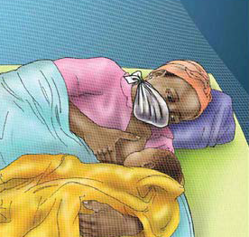
Measures with COVID-19
Hand washing
Use a face cover
Respiratory hygiene
Good nutrition
Advise family
Do NOT put face covers on neonates, infants and children < 2 years.

Slide 5
Breast milk expression:
When to do it ?
Precautions
Feeding
Storage
Wet nursing
Breast milk donation
Breast milk substitutes

Slide 6
Complementary feeding
Foods should meet the basic criteria for complementary feeding which includes, FATVAH.
Frequency
Amount
Texture
Variety
Active feeding/ Responsive Feeding
Hygiene

Slide 7
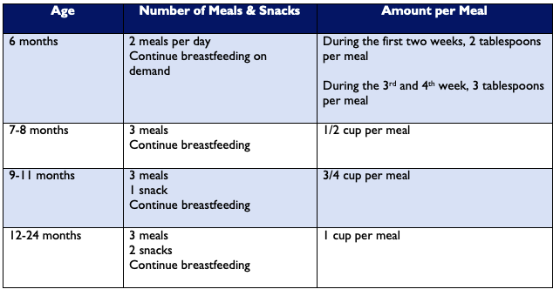
Current Guidelines

Slide 8
When Covid 19 is Suspected or Confirmed
Assess the level of hygiene
The child should not consume chewed food
The child should consume extra fluids and foods to recover faster.
Breastfeed the child more often and have them eat soft foods
After sickness, the child should feed more often than usual for about two weeks, to help them regain strength.

Slide 9
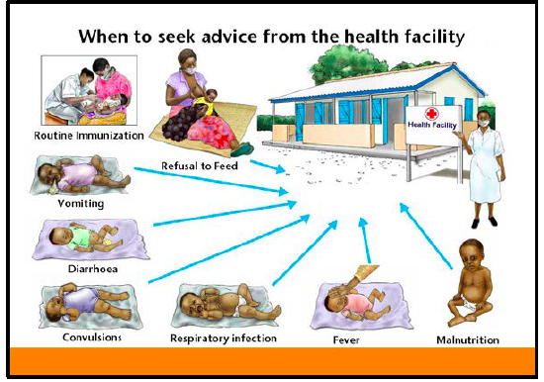

Slide 10
Look out For:
COVID-19 symptoms, including fever, dry cough, and difficulty in breathing
Refusal to feed and limp, or weak
Vomiting (cannot keep anything down)
Diarrhoea (more than 3 loose stools a day for two days or more and/or blood in the stool, sunken eyes)
Convulsions (rapid and repeated contractions of the body, shaking)
The lower part of the chest sucks in when the child breathes in, or it looks as though the stomach is moving up and down (respiratory infection)
Fever
Malnutrition (visible thinness or swelling of the body)

Slide 11
Messages
Precautions at home
Precautions during pregnancy
Precautions at delivery
Precautions when breastfeeding
Precautions when introducing food
General precautions

Slide 12
References and Resources
Infant and Young Child Feeding Recommendations When COVID-19 is Suspected or Confirmed: Recommended Practices Booklet: https://www.advancingnutrition.org/news-events/2020/04/24/infant-and-young-child-feeding-recommendations-when-covid-19-suspected-or
Infant and Young Child Feeding in the Context of the COVID-19 Pandemic Eastern, Central and Southern Africa https://www.unicef.org/esa/documents/infant-and-young-child-feeding-context-covid-19-pandemic-eastern-central-and-southern
Sexual and reproductive health, Pregnancy, Childbirth, breastfeeding and COVID-19 https://www.who.int/reproductivehealth/publications/emergencies/COVID-19-pregnancy-ipc-breastfeeding-infographics/en/
Key Messages Booklet in the UNICEF Community Infant and Young Child Feeding Counselling Package for additional important information about complementary feeding : https://www.unicef.org/nutrition/files/Key_Message_Booklet_2012_small.pdf
Breastfeeding advice during the COVID-19 outbreak, http://www.emro.who.int/ar/noncommunicable-diseases/campaigns/breastfeeding-advice-during-the-covid-19-outbreak.html

Slide 13
Questions and Feedback
Thank you for joining !

